Slide 1
STAGE RAGE:
THE ST. BENEDICT’S PREPARATORY MODEL
Patricia Flynn, MFA
Ivan Lamourt, Psy. D.

Slide 2
WHAT IS PERFORMING ART THERAPY?
The systematic and intentional use of drama/theatre processes, products, and associations to achieve the therapeutic goals of symptom relief, emotional and physical integration, and personal growth.
It is an active approach that helps the client tell his/her story to solve a problem, achieve a catharsis, extend the depth and breadth of inner experience, understand the meaning of images, and strengthen the ability to observe personal roles while increasing flexibility between roles (National Drama Therapy Association, 2004).
It uses play, embodiment, projection, role, story, metaphor, empathy, distancing, witnessing, performance and improvisation to help people address sensitive situations and make meaningful change.
This is an effective intervention for addressing a wide range of issues that interfere with students’ abilities to be fully present for learning and life.

Slide 3
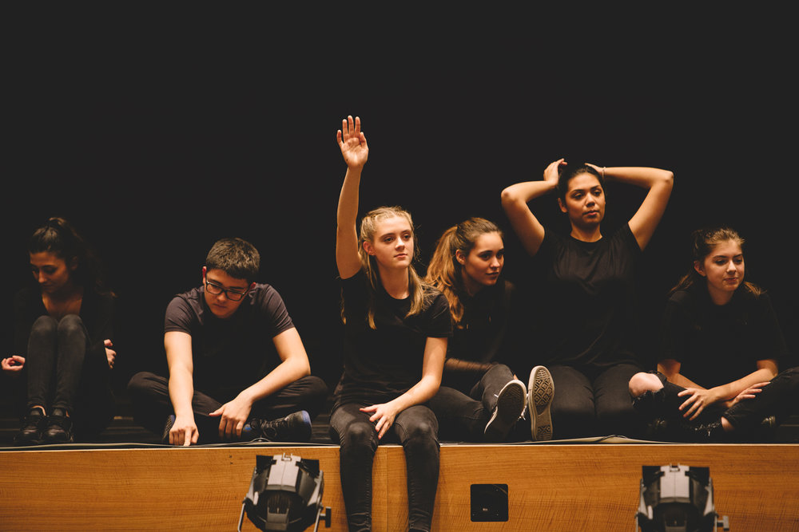
PERFORMING ART THERAPY IN SCHOOLS
Professional Practices:
Can be used as an assessment/screener to identify high-risk/vulnerable students, of student abilities and preferences, of life experiences and capacities, of psychological, psychosocial, and/or cognitive aspects
Creates a positive association with school, increasing likelihood of academic success, etc.
Fosters a respectful and collaborative school environment

Slide 4
PERFORMING ART THERAPY IN SCHOOLS
Client Conditions:
At-risk youth, Autism Spectrum Disorder, Attention-Deficit/Hyperactivity Disorder, Oppositional Defiant Disorder, Conduct Disorder, Attachment Disorders, Depression, Anxiety Disorders, Eating Disorders, Addiction/Children of Addicts, Trauma/PTSD, the medically fragile, Developmentally-Disabled Individuals, LGBTQIAP2S, Looked-After-Children (LAC), refugees/immigrants, children of divorce, those experiencing loss, those living in poverty/danger, those experiencing suicidal thoughts, ideations, and attempts
Client Uses:
To address bullying situations, build self-esteem, improve self-regulation/emotional regulation, social skills training, address trauma, build assertiveness/self expression, increases physical activity which is known to aid in depressive symptoms, gain exposure to models of empathy and acceptance, enhance peer and outside relationships, address the cycle of domestic/related abuse, positive impacts on academic performance and in-school behavior, and supports the understanding of their own emotions

Slide 5
WHAT IS STAGE RAGE?
The purpose of Stage Rage as an intervention is to reduce antisocial behaviors as well as promote positive lifestyles for at-risk youth.
Stage Rage is a performing art therapy intervention which is grounded in three mental health approaches.
Psychodrama: a therapeutic approach that uses the performing arts as a medium to allow individuals to express their emotions by facilitating both insight and personal growth
Drama Therapy: the use of forms of drama and theatre to assist clients in exploring personal and collective problems to bring forth change
Self-revelatory Performance: a specific form of drama therapy and theatre in which actors create an original theatre piece based on current unresolved quality of life issues with a goal of healing and psychologically coming to terms with these problems

Slide 6
STAGE RAGE: THE ST. BENEDICT’S PREPARATORY SCHOOL MODEL
In 2015, Stage Rage emerged as St. Benedict’s unique model of drama therapy.
St. Benedict’s Preparatory School has a significant population of at-risk, adolescent males. The student population is approximately 51% African American, 34% Latino, 9% Caucasian, and 6% other. Additionally, more than 80% of the student body received financial aid.
At-risk youth: children and adolescents who are less likely to experience success in childhood or adulthood
Due to family conflict and abandonment, encounter barriers to securing employment and healthcare, struggle with homelessness, are more susceptible to drug abuse, are more likely to become pregnant while in their teenage years, engage in delinquency and school dropout, in addition to being more likely to experience physical and sexual abuse
At greater risk for developing mental health disorders, alcohol and substance abuse disorders, suicidality, poorer cognitive functions, poor problem-solving skills, impaired judgement, and combative interpersonal relationships
Adolescents of minority backgrounds and lower socio economic statuses are overrepresented in the at-risk youth population
The demographic composition at St. Benedict’s is highly compatible with that of populations in which performing art therapy approaches are extremely effective interventions

Slide 7
STAGE RAGE: THE ST. BENEDICT’S PREPARATORY SCHOOL MODEL
Participants: Students are recruited to participate from the various group therapies offered at St. Benedict’s. These students are typically between 14 and 16 years old and in need of a “break through”. Students may also request placement in the course, however, they must attain special approval. Please note: through this course, students have the opportunity to receive community service credit which is a graduation requirement.
Drama teacher: directs scenes/tableau; helps with service delivery
Therapist: assists to dig up buried feelings and found out the “why”
Duration: The course is offered once a year and runs for a 4 to 5 week period during the Spring semester.
Intervention is conducted for 5.5 hours/day, 5 days/week
They participants attend an exclusive group therapy for 1.5 hours/day in the morning
Process: Depending on classroom dynamics and the students’ presenting issues, the therapeutic process may vary. Typically, the drama teacher and therapist implement one of the five performing therapy techniques mentioned in the following slide.
Homework: For homework, the students are required to journal about the emotions they experienced during class or work on scripting their assigned scenes.
Final Project: At the end of the semester, the students will perform a piece they created based on their own lives in surrounding, local middle schools.

Slide 8
STAGE RAGE: THE ST. BENEDICT’S PREPARATORY SCHOOL MODEL
Story Making:
Using tableaux, we build a dramatic outline of each scene, like a storyboard with human bodies. We begin to give physical life to the stories we want to share. Initially, students act out scenes from their lives as closely as possible to the way they happened. Students appear in one another’s scenes, especially those with which they have a personal understanding. Being asked to play an abusive father, or an alcoholic mother, when one actually lives with one, forces a student to examine issues from that person’s perspective. Few people regard themselves as villainous. When you play the antagonist, you must add dimension - we all have many layers - good and bad. Students gain insight into their own emotions, and the emotional lives of those around them. From this work, we begin the process of playwriting and editing. While the final stories are true, they are not necessarily real. Time is compressed; nonessential characters are removed, focus is shaped in ways we rarely experience in real life. Thus is a performance created, one that shares the insights borne of experience, without exposing that which the actors prefer to keep private. It is a distilled truth - and therefore all the more powerful.
Tableaux Vivants:
A tableau is a moment frozen in time, as if a group had been captured in a photograph. A tableau is silent and still, allowing the participants, acting as performers and audience, to reflect critically on what is being communicated by the image. There is no dialogue; the bodies speak the truth. Students use posture, gesture and facial expression to communicate a word, or a moment in a scene. Themes for the tableaux are suggested by discussions that arise in Group Therapy. Through tableaux, we begin to explore theatrically, issues that students have in common. And in pretending, they experience the freedom to communicate truthfully that which they hide in everyday life.

Slide 9
STAGE RAGE: THE ST. BENEDICT’S PREPARATORY SCHOOL MODEL (cont’d)
Improvisational Games:
Theatre games and exercises, such as mirror, sound and movement duplication, and Good Angel/Bad Angel are used to build students’ awareness of one another’s skills, as well as to strengthen their intuitive sense of the ensemble. The five senses are awakened through the Theatre of the Oppressed exercises developed by Augusto Boal, critical in working with those who have become numb in an attempt not to feel their pain. And we play: we warm up the body through physical games. As one student said about our sessions following Group Therapy, “In the morning we cry, and then, in the afternoon, we laugh.” Relaxation and a nonjudgmental atmosphere are essential to creativity.
Dalcroze Eurhythmics:
This approach is comprised of three tenets. Eurhythmics, which emphasizes the relationship between time, space, and energy as it relates to movement and music through exercises utilizing movement, improvisation, and active listening. The second tenet, solfege, utilizes movement, improvisation and the voice to facilitate aural development and understanding. Improvisation is the third tenet and encompasses the use of vocalized sounds, words, poems, and movement to facilitate the development of spontaneous and creative expression. This fosters a sense of freedom, feeling more connected to others, feeling more socially integrated, and the students’ growth in communication skills.

Slide 10
EFFECTIVENESS OF STAGE RAGE
In 2017, a study was conducted by a doctoral student to measure the effectiveness of Stage Rage at St. Benedict’s Preparatory School.
Participants:
61males
African-American, Caucasian, and Latino descent
14-19 years old
who participated in Stage Rage previously
Measures:
To evaluate the social/emotional functioning of the students before and after participating in Stage Rage, the Behavior Assessment System for Children, Second Edition (BASC-2) and the Behavior Assessment System for Children, Third Edition (BASC-3) were utilized.

Slide 11
EFFECTIVENESS OF STAGE RAGE
Dependent Variable:
Participants’ anxiety scale, depression scale, attitude to school scales, internalizing problems composite, interpersonal relations scale, self-esteem scale, and emotional symptoms index scores.
Independent Variable:
Stage Rage intervention

Slide 12
EFFECTIVENESS OF STAGE RAGE
Results: This study revealed several areas where the Stage Rage intervention was helpful in supporting students to improve several areas of social-emotional functioning.
Anxiety Scale: There was a significant decrease in anxiety levels which suggests that Stage Rage assisted in reducing generalized fears, nervousness, and worries which are traditionally poorly defined and irrational in the mind of the students.
Depression Scale: There was no significant change in this scale which suggest that Stage Rage did not assist in improving the students’ feelings of sadness, loneliness, and inability to enjoy life.
Attitude to School Scale: There was no significant change found in this scale. This suggests that Stage Rage did not assist in improving the students’ general opinion of the utility of school nor their comfort level with school-related matters.
Internalizing Problems Composite: As predicted, there was a significant decrease in this composite which suggests that Stage Rage assisted students in feeling better about mood problems that are typically identified as inwardly directed.
Interpersonal Relations Scale: There was a significant increase in this scale which suggests that Stage Rage did assist in the improvement of relations with others as well as the degree of enjoyment derived from those interactions.
Self-esteem Scale: There was no significant change in this scale which suggests that Stage Rage did not assist in improving the students’ self-satisfaction in the context of both physical and global characteristics.
Emotional Symptoms Index: There was a significant decrease in this composite score which suggests that Stage Rage assisted in reducing the presence of serious, global emotional disturbances that are broad based on both the feelings and thoughts of the students.

Slide 13
REFERENCES
https://www.nadta.org/what-is-drama-therapy/nadta-pr-packet-2019-finalized.pdf
Moore, J., Andersen-Warren, M. & Kirk, K. (2017). Dramatherapy and psychodrama with looked-after children and young people. Dramatherapy, 38(2-3), 133-147. doi:10.1080/02630672.2017.1351782
Dix, A. (2015). Telling stories: Dramatherapy and theatre in education with boys who have experienced parental domestic violence. Dramatherapy, 37, 15-27. doi:10.1080/02630672.2015.1055778
Moneta, I., & Rousseau, C. (2008). Emotional expression and regulation in a school-based drama workshop for immigrant adolescents with behavioral and learning difficulties. The Arts in Psychotherapy, 35(5), 329-340. doi:10.1016/j.aip.2008.07.001
Malchiodi, C. A. (2007). Expressive therapies. New York: Guilford.

